Slide 1

REPUBLIC OF SLOVENIA
MINISTRY OF PUBLIC ADMINISTRATION
INFORMATION SOCIETY DIRECTORATE
Digitalisation of Slovenia
Marjan Turk, Information Society Directorate
Ministry of Public Administration
Nur-Sultan, Kazakhstan, 16. – 17. 9. 2019
55. RCC Board

Slide 2

DESI 2019
Digital Economy & Society Index
Connectivity
Fixed BB networks
Mobile BB networks
Speed
Accessibility - prices
Basic skills and use
Advanced skills and ICT & content creation
Citizens use of content
Communication
Online transactions
Digitisation of Industry
eBusiness
eCommerce
eGovernment
Use, forms, functionality, open public data
Digital Public Services
Human capital
Integration of Digital Technology
Use of Internet

Slide 3



It‘s time for the digital transformation of Slovenia!
Digital Agenda for Europe (2010)
To take advantage of ICT for a sustainable digital economic growth and social benefits.
DIGITAL SLOVENIA 2020 (2016)
Digitalisation of Slovenia with intensive and innovative use of ICT and the Internet in all segments of society.
Establish and reap the benefits of a single European digital market (space).
DIGITAL SINGLE MARKET Strategy (2015)

Slide 4
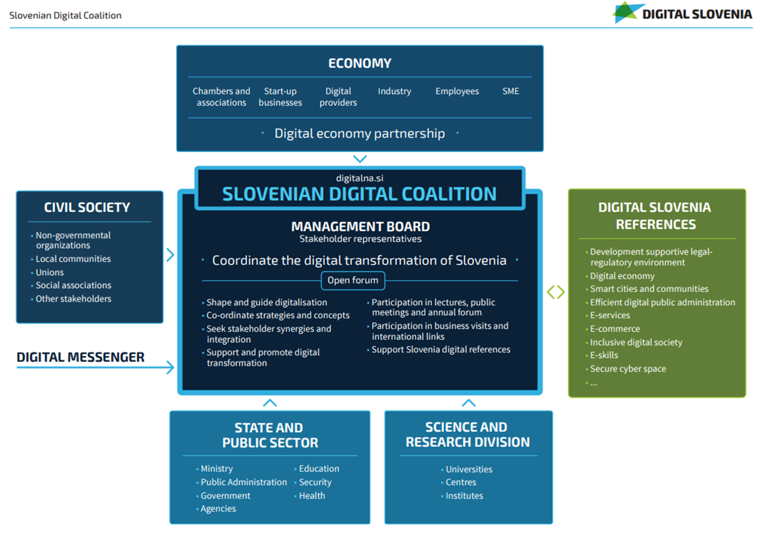
Slovenian Digital Coalition

Slide 5
Strategic background
Commission Communication "Connectivity for a Competitive Digital Single Market: Towards a European Gigabit Society"
Commission Communication „5G fo Europe: An Action Plan"
To update National Broadband Plans:
2020: 5G in at least one major city
2025: Gigabit connectivity for socio-economic drivers; schools, transport hubs, public body
2025: 5G for urban areas and transport paths
2025: 100 Mb/s for all → 1 Gb/s

Slide 6
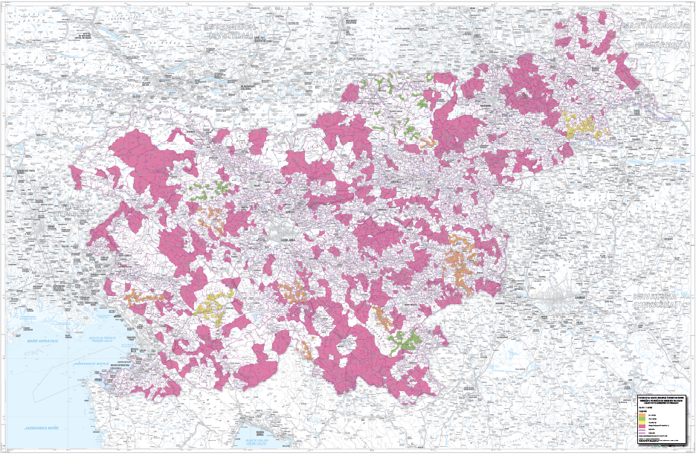
WHITE SPOTS
The white areas data base is made public and is an indispensable and necessary tool for all that plan the application to a public tender.

Slide 7
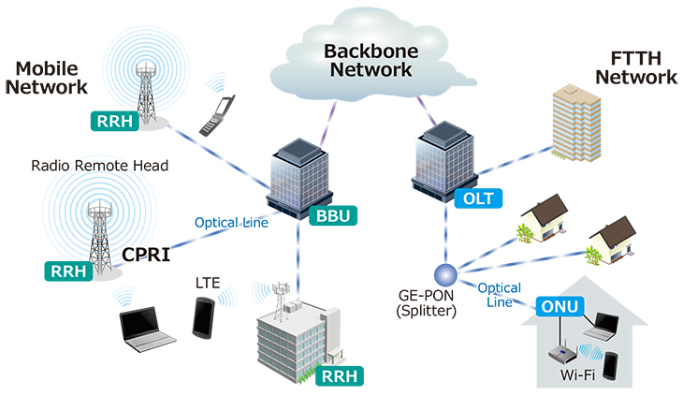
NEW 5G MOBILE ARCHITECTURE – MORE FIBER OPTICS

Slide 8
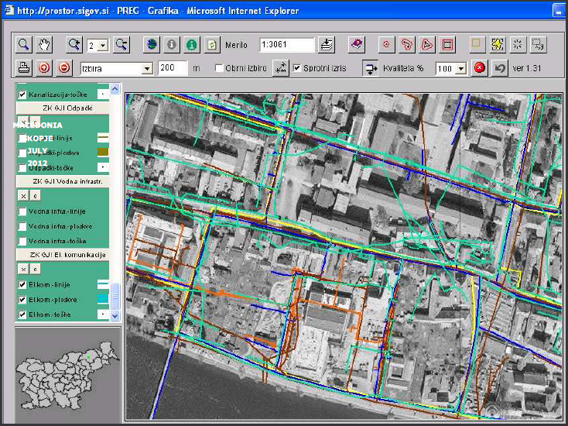
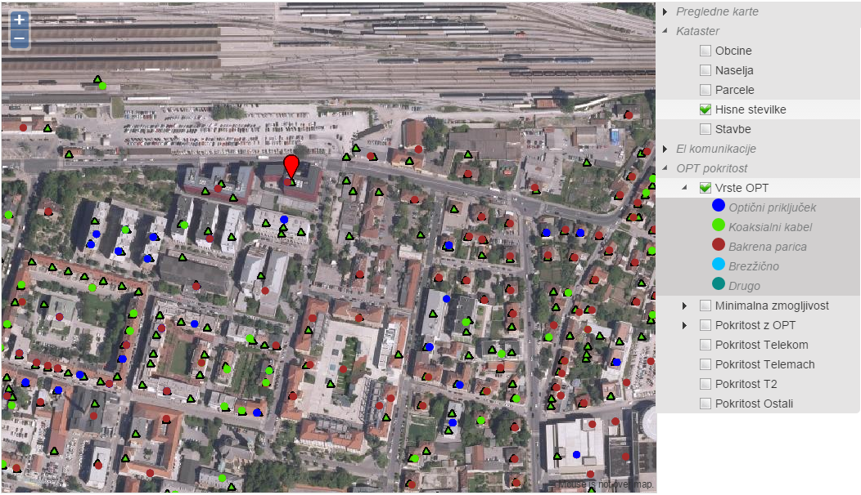
Consolidated Cadastre
of Public Economic
Infrastructure

Slide 9
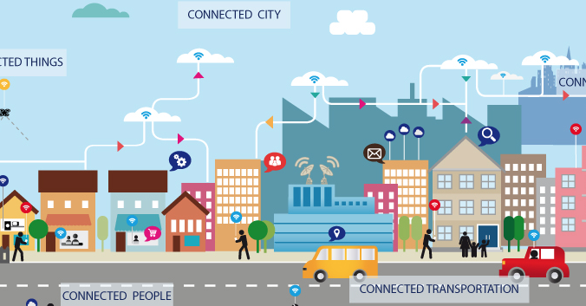

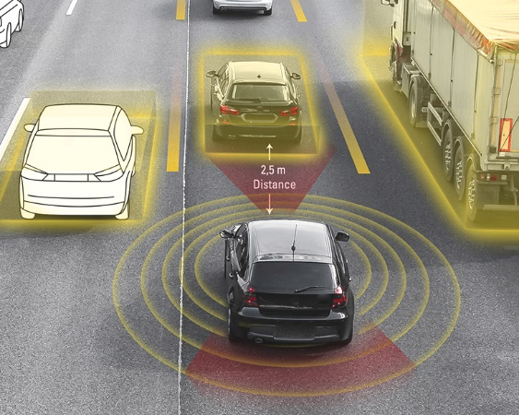
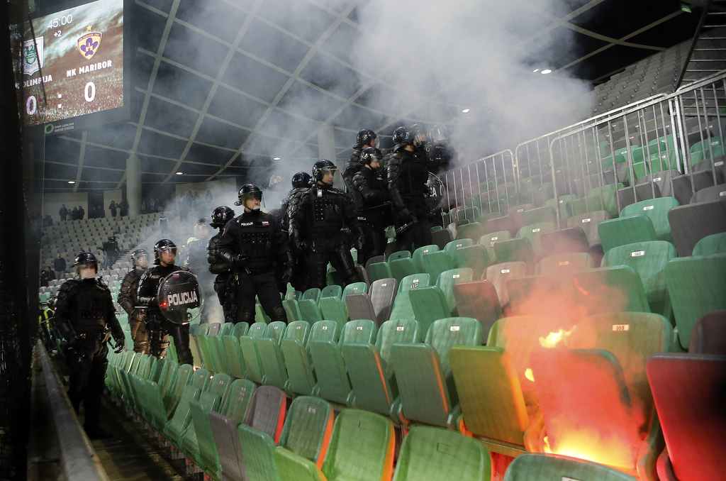
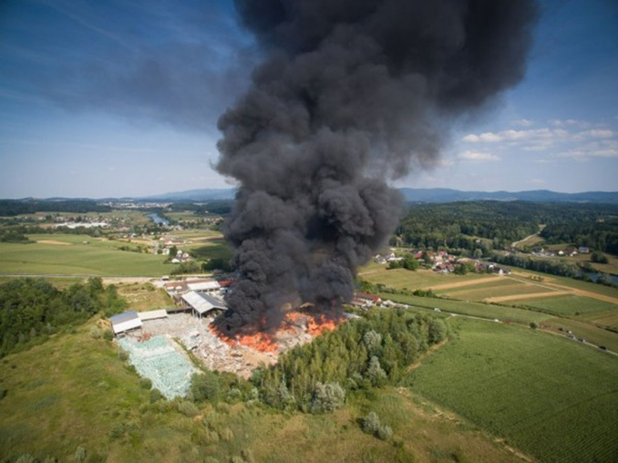
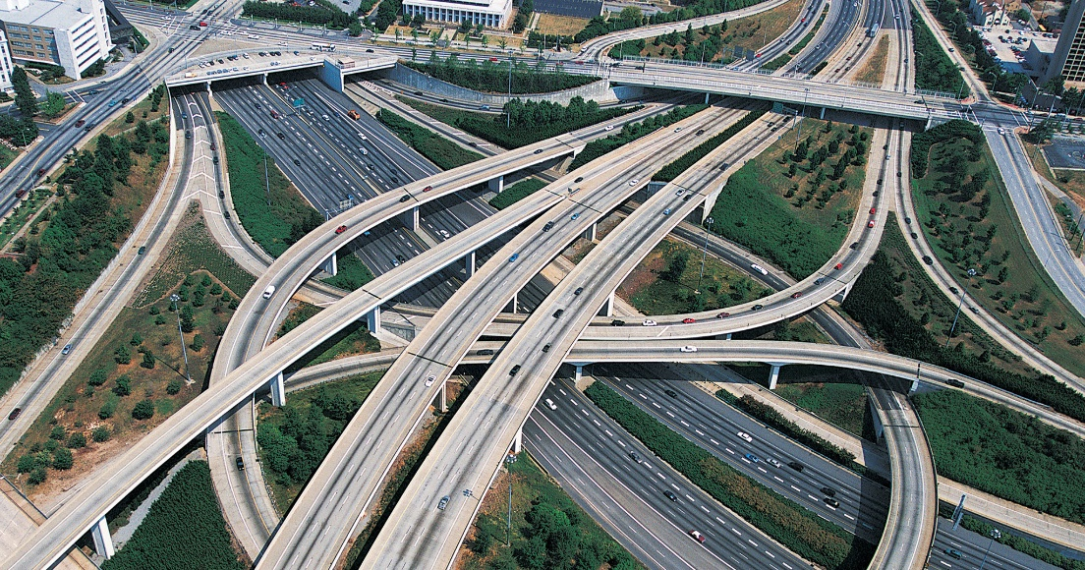
5G Vertical Challenges
Smart cities IoT
e-health
CAD
PPDR
Digital transformation of global society, smart cities, global warming, natural disasters, terrorism

Slide 10
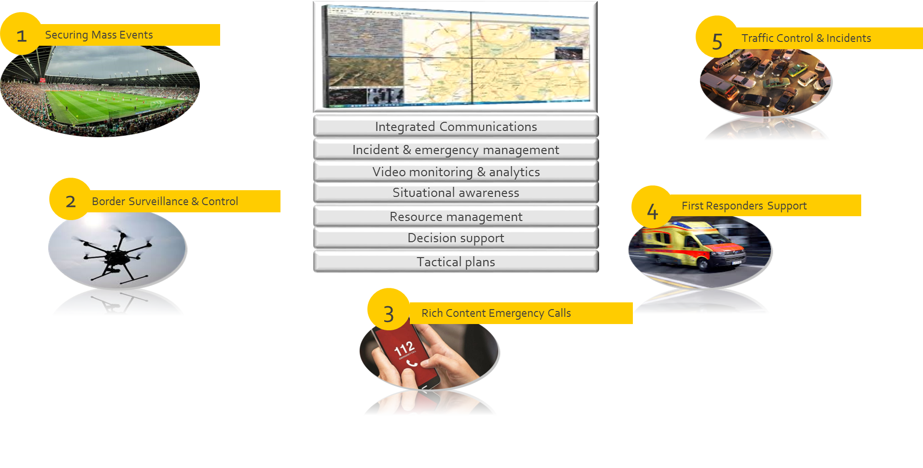
Next Generation Operations Center
… for future challenges in PPDR

Slide 11
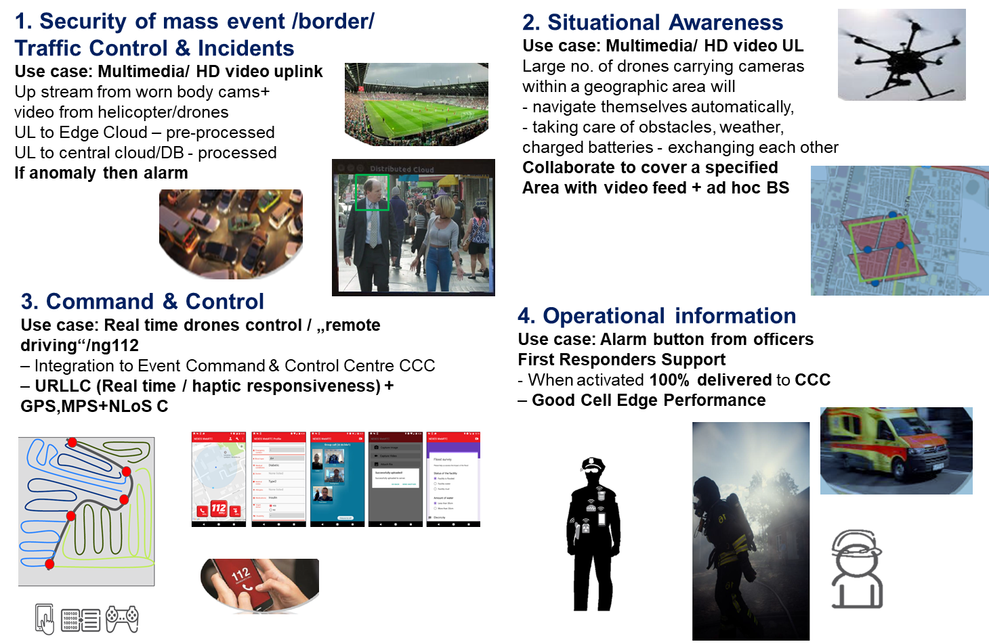
5G PPDR use case scenario

Slide 12
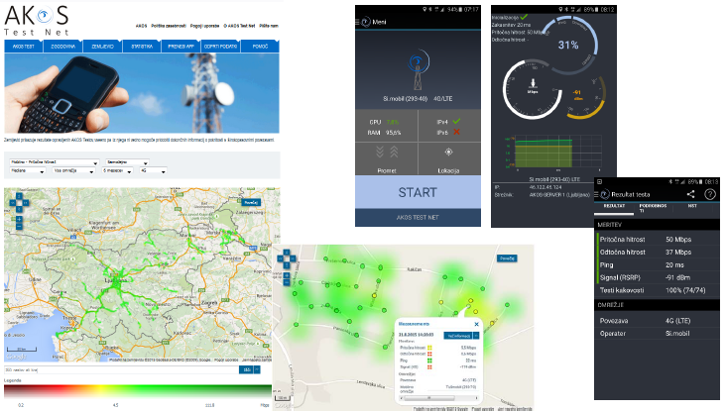
Bit rate measurements done by users – AKOS Test Net

Slide 13
Načrt NGN 2020 – Strateški cilji
Thank you for your attention
Marjan Turk, Information Society Directorate,
Ministry of Public Administration
marjan.turk@gov.si

